Slide 1
PillEasy
An app which keeps track of time when patient needs to have medicine and alerts him/her regarding the same, along with other add-on features
By:
Harshit Gupta
Madiha Tariq
Mohnish Basarkar
Niharika
Shrey Rastogi

Slide 2
MOTIVATION
The motivation to build this product came from observing the elderly people in the family having to suffer through the stress of missing out pills in absence of regular supervision.
Many times hospitals also display lack of supervision. People sometimes take incorrect medicines due to lack of information or misjudgement. Neither do they have a proper listing of the medicines they are taking and when to consume them. All these happenings motivated us to come up with an easy solution for the aged and the ailing.

Slide 3
RELATED WORK
There are many apps in this domain and the main players are MyTherapy Pill Reminder and Medisafe Pill Reminder and Medication Tracker both of them have more than 10 lakhs + downloads but they all lack one main functionality which is showing the photo of a medicine also while taking or shopping for the same medicine as many people have different pronunciation for the same medicine.

Slide 4
APPROACH
Firstly, draw a sketch of the idea and different activities to happen in the app.
Design the UI and integrate technology for directly entering the app.
Manually entering the names of medicines, time and quantity to be taken and the rest of the other information of the patient.
Integrating the calendar and more relevant things required.

Slide 5
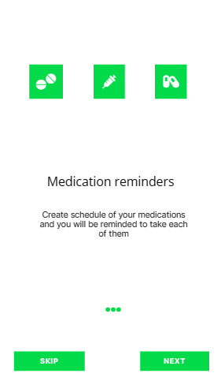
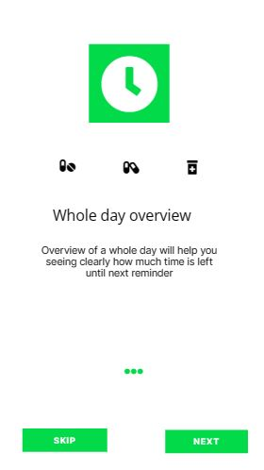
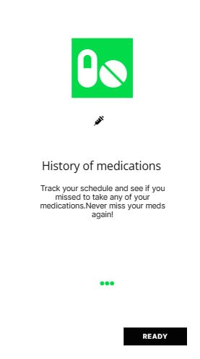
ACTIVITY 1

Slide 6
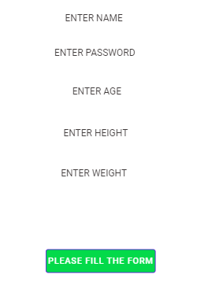
ACTIVITY 2

Slide 7
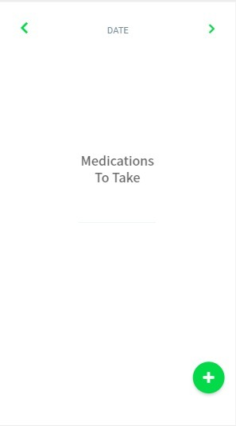
ACTIVITY 3

Slide 8
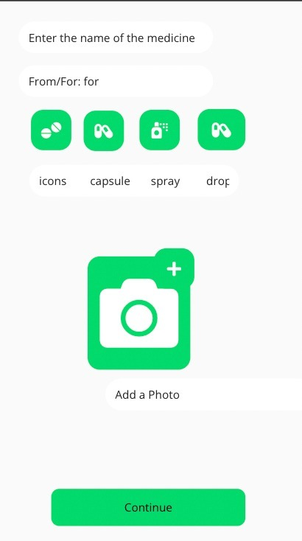
ACTIVITY 4

Slide 9
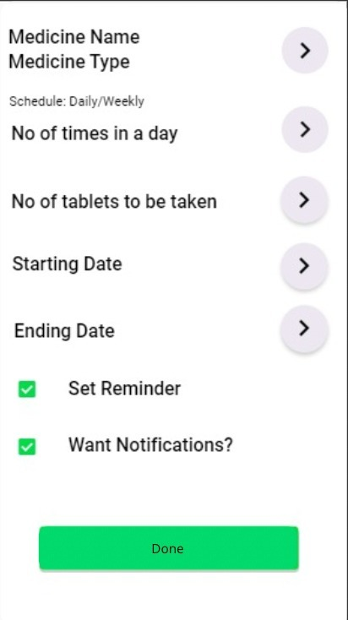
ACTIVITY 5

Slide 10
TOOLS/ SKILLS REQUIRED
SQLite Database
Java
Android Studio

Slide 11
OUTCOME
The outcome of the project will be a fully fledged app that will suit users behaviour and needs. The app basically is a reminder application to alert users to take their medicines regularly on time with several more features.

Slide 12
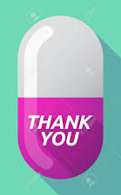
ANY QUESTION?

